Slide 1
FORECAST COMMUTERS INFLOW FOR AIRLINE INDUSTRY IBM CLOUD SERVICES
TEAM DETAILS
VADICHERLA NARESH (18UK1A05H7)
LAKKARSU SHIVA (18UK1A05K6)
SAI REVANTH METTELA (18UK1A05M0)
BOMMA KAVYA (18UK1A05J4)

Slide 2
CONTEXT
INTRODUCTION
BLOCK DIAGRAM
EXISTING PROBLEM
PROPOSED SOLUTION
ADVANTAGES
DISADVANTAGES
RESULT
CONCLUSION

Slide 3
INTRODUCTION
Air passenger traffic forecast is of great importance for airlines and civil aviation authorities. For airlines, accurate forecasts play an increasingly important role in revenue management. It helps to reduce the airlines’ risk by objectively evaluating the demand of the air transportation business. For civil aviation authorities, air passenger traffic forecast provides a concrete basis for planning decisions in air transport infrastructure. Time series forecasting is the use of a model to predict future values based on previously observed values. The main objective of this project is to build a prophet time series model that forecasts the passenger traffic for a given date.

Slide 4
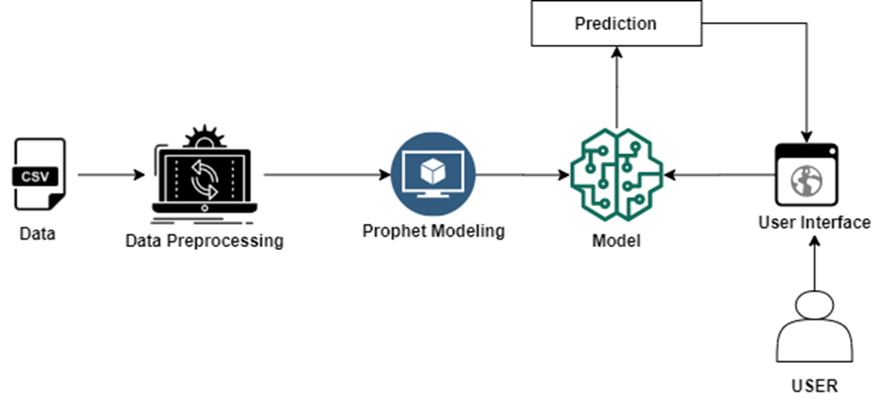
BLOCK DIAGRAM

Slide 5


EXISTING PROBLEM
From time crunch and flight delays to waiting lines and cumbersome carry-on luggage, airplane travel can stress even the most nomadic traveller. It’s easy to let the hassle get the best of people, but knowing how to manage airline obstacles will help relieve the tension and get you to your destination with minimal stress.
To minimize time spent at the security checkpoint, be prepared and travel light, minimizing obstacles to safe, smooth travel. Make the security checkpoint go by quickly by emptying pockets ahead of time, removing laptop from bags, and removing shoes and belts to not only make it faster for you, but for those behind you. Also make sure that all liquids are in the appropriately sized containers before heading to the airport.

Slide 6
PROPOSED SOLUTION
We use prophet library to build our model.
Facebook prophet library is the third-party library that could all the fine-tuning part within, and we just need to feed the model .
The main idea of our project is to create an application for forecasting the passengers by using this library.
Today Facebook is open sourcing Prophet, a forecasting tool available in Python and R.
Forecasting is a data science task that is central to many activities within an organization. For instance, large organizations like Facebook must engage in capacity planning to efficiently allocate scarce resources and goal setting in order to measure performance relative to a baseline.
Producing high quality forecasts is not an easy problem for either machines or for most analysts.

Slide 7
ADVANTAGES
Prophet makes it much more straightforward to create a reasonable, accurate forecast. The forecast package includes many different forecasting techniques (ARIMA, exponential smoothing, etc), each with their own strengths, weaknesses, and tuning parameters. We have found that choosing the wrong model or parameters can often yield poor results, and it is unlikely that even experienced analysts can choose the correct model and parameters efficiently given this array of choices.
Prophet forecasts are customizable in ways that are intuitive to non-experts. There are smoothing parameters for seasonality that allow you to adjust how closely to fit historical cycles, as well as smoothing parameters for trends that allow you to adjust how aggressively to follow historical trend changes. For growth curves, you can manually specify “capacities” or the upper limit of the growth curve, allowing you to inject your own prior information about how your forecast will grow (or decline). Finally, you can specify irregular holidays to model like the dates of the Super Bowl, Thanksgiving and Black Friday.

Slide 8
disadavnAtages
Works well with only stationary data.
Prior knowledge is required.
Can’t handle data with seasonal components and irregularities.
Becomes complex and fails to predict accurately.
Real time data is often nonlinear.

Slide 9
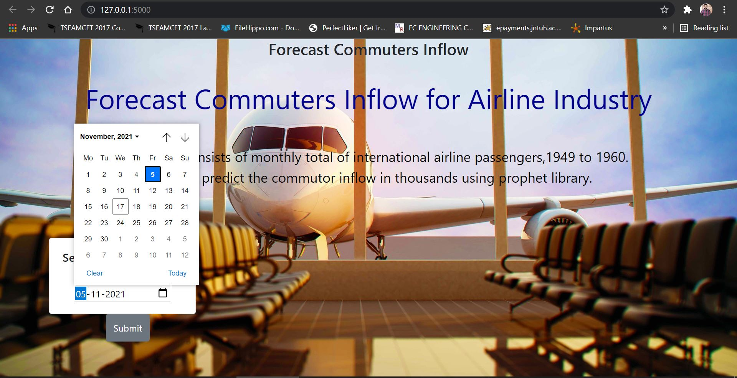
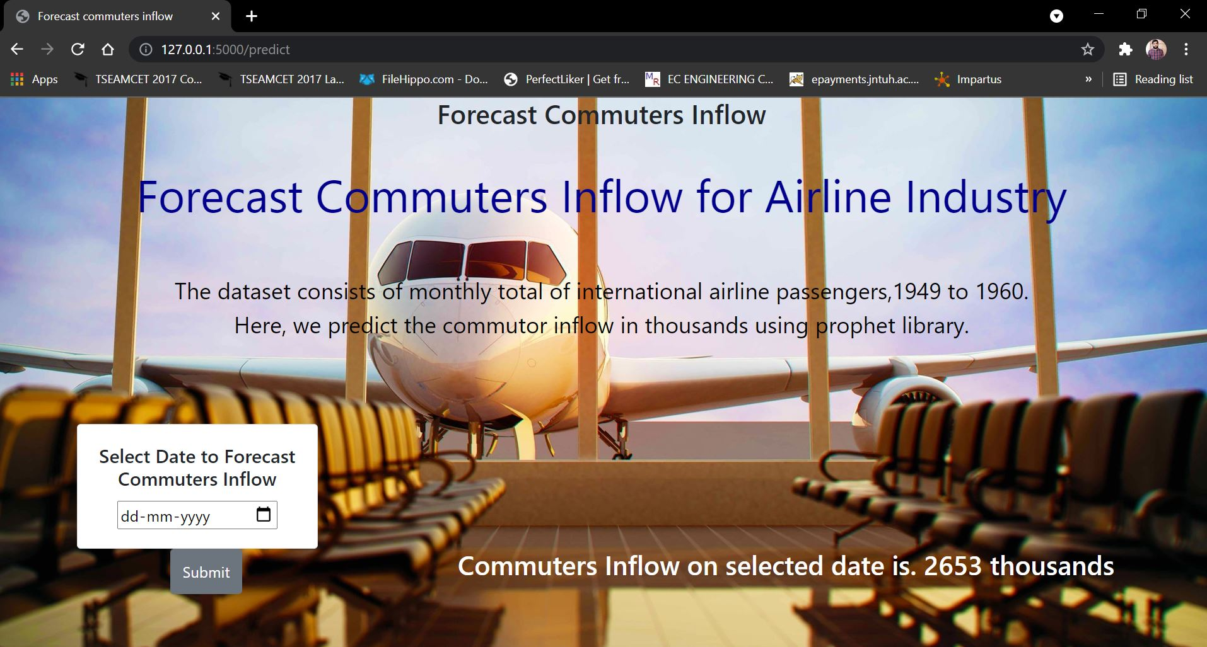
RESULT

Slide 10
CONCLUSION
Will be able to know the fundamental concepts of time series forecasting.
Working with Prophet library.
Flask Application Development.
How Prophet can be used to make time series forecasts.
How to analyse trends and seasonal fluctuations using Prophet.

Slide 11
THANK YOU

